Slide 1
The Longest almost-Increasing Subsequence
Amr Elmasry,
Max-Planck Institut für Informatik, Saarbrücken,
Germany,
Information Processing Letters, 2010
Presenter: Zhi-Cheng Shen
Date: May.23, 2023

Slide 2
Abstract
Given a sequence of n elements, we introduce the notion of an almost-increasing subsequence as the longest subsequence that can be converted to an increasing subsequence by possibly adding a value, that is at most a fixed constant, to each of the elements. We show how to optimally construct such subsequence in O(n logk) time, where k is the length of the output subsequence.

Slide 3
Longest almost Increasing Subsequence
String: 7, 15, 2, 14, 14, 6, 8, 11, 17, 15, 14, 13
c = 2
LaIS: 2, 6, 8, 11, 14, 13
∀_{i} y_{i} > max^{i−1} _{j=1} y_{j} −c

Slide 4
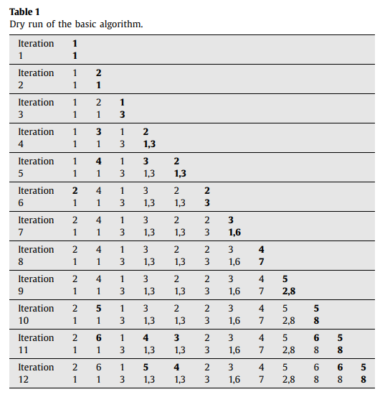
Basic Algorithm
7
15
2
14
14
6
8
11
17
15
14
13
Step1: 找出目前為止小於自己的最大值，然後接續在後面。
Step2: 更新那些到目前為止介於x_{i} <= x_{j} < x_{i} + c的長度，將他們的長度加一。
<7, 15, 14, 14, 15, 14>, <7, 6, 8, 11, 15, 14>, <2, 6, 8, 11, 15, 14>, <7, 6, 8, 11, 14, 13>,
<2, 6, 8, 11, 14, 13>
From i = n to m + 1, and output the elements satisfying x_{m} − c < x_{i} <= x_{m} followed by x_{m}

Slide 5
Time Complexity
O(n²): n回合，每回合須找出當前最大值O(n)

Slide 6
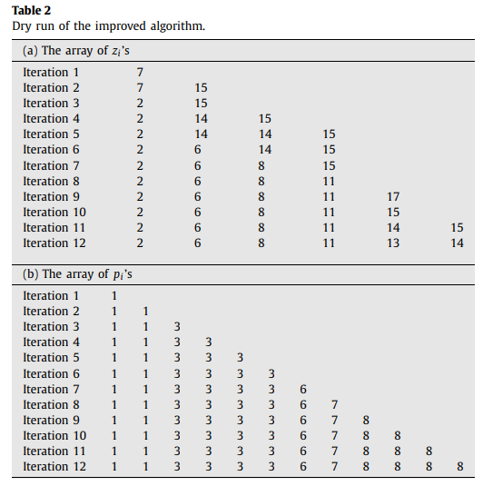
Improved Algorithm
7, 15, 2, 14, 14, 6, 8, 11, 17, 15, 14, 13
C = 2
Data structure for z: AVL tree,
Splay tree 達到每回合插入和刪除都是O(logk), K 為當前回合的資料量

Slide 7
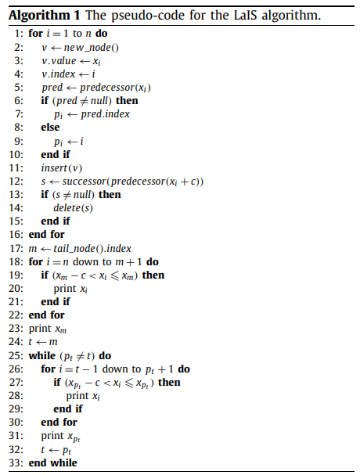
Improved Algorithm
At each iteration the algorithm performs: two predecessor searches, one successor finding, one insertion and a possible deletion.

Slide 8
Time complexity
O(nlogk)，共n回合，每回合需O(logk)的時間

Slide 9
Thanks~

